Slide 1
COSC3500: Optimising Electron Interaction Simulation
Tristan Duncombe s4702098
5 August 2024

Slide 2
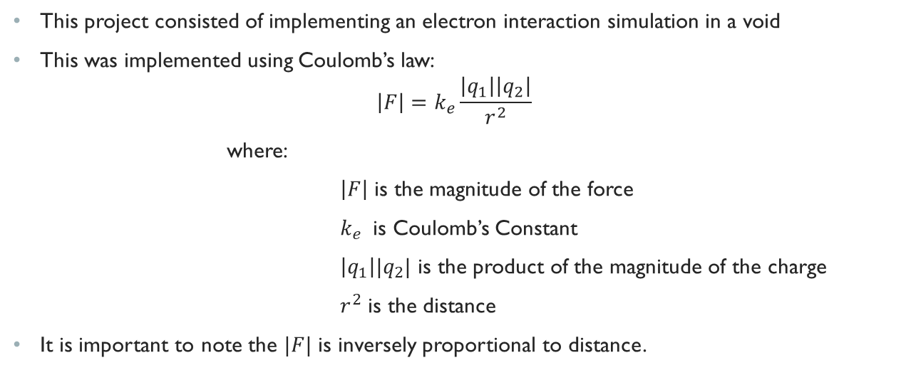
The project
This project consisted of implementing an electron interaction simulation in a void
This was implemented using Coulomb’s law:
$$\left|F\right|=k_{e}\frac{\left|q_{1}\right|\left|q_{2}\right|}{r^{2}}$$
where:
$\left|F\right|$ is the magnitude of the force
$k_{e}$ is Coulomb’s Constant
$\left|q_{1}\right||q_{2}|$ is the product of the magnitude of the charge
$r^{2}$ is the distance
It is important to note the $|F|$ is inversely proportional to distance.

Slide 3
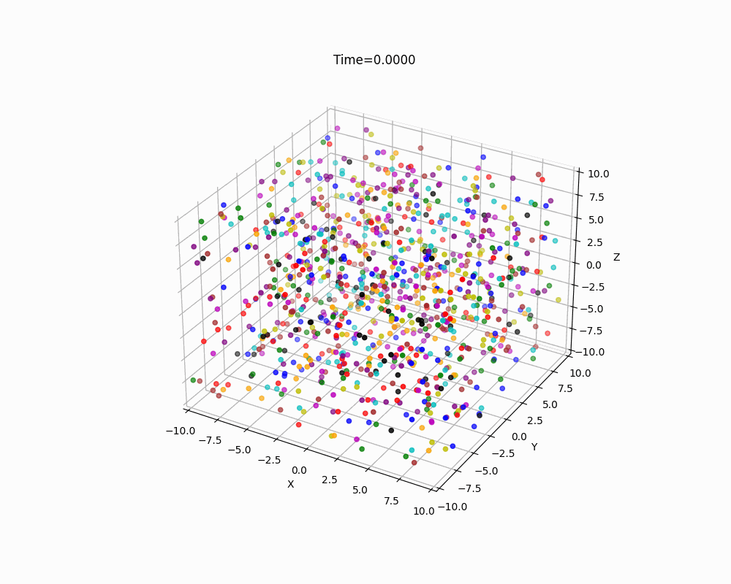
Figure 1: Final Implementation of Project

Slide 4
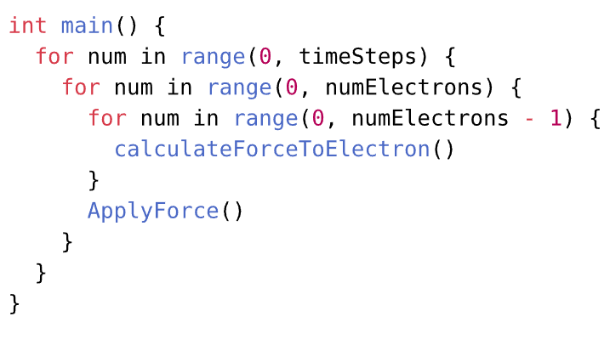
Initial implementation
To initially implement the simulation, a simple approach was taken.
All 1000 electrons were randomly placed within a 1m-by-1m-by-1m volume.
For each 0.1s period of time:
Every electron calculates the force imposed on it.
Using trigonometry, we can calculate this force to see how it would change the X,Y,Z position.
Figure 2: Simple Pseudo Code of Simulation

Slide 5
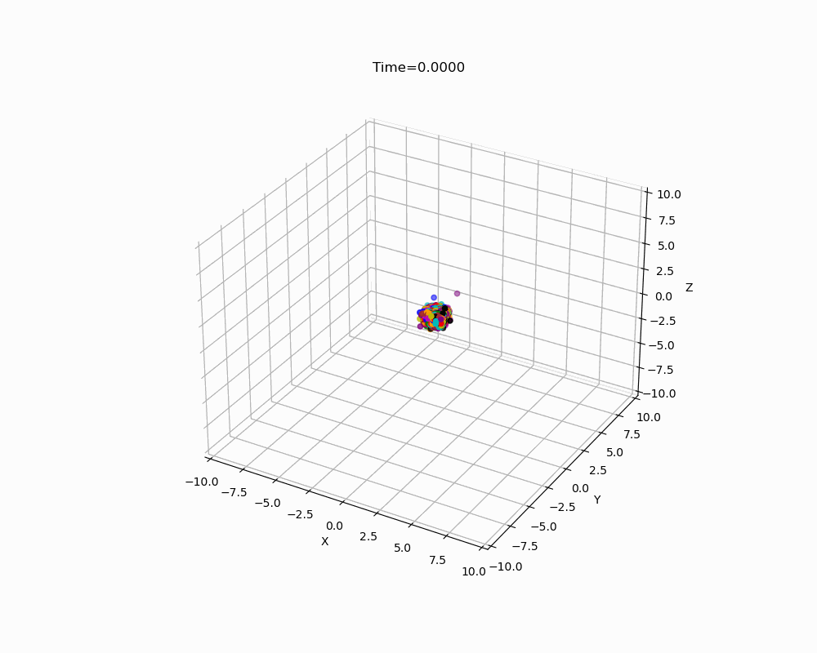
Initial implementation: Visualisation
Figure 3: Initial Implementation Visualisation

Slide 6
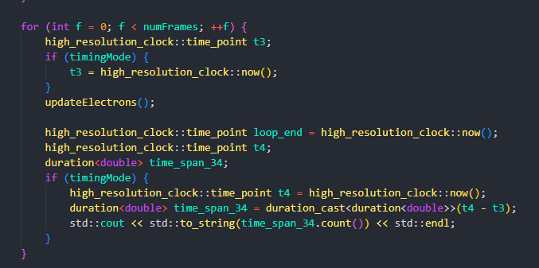
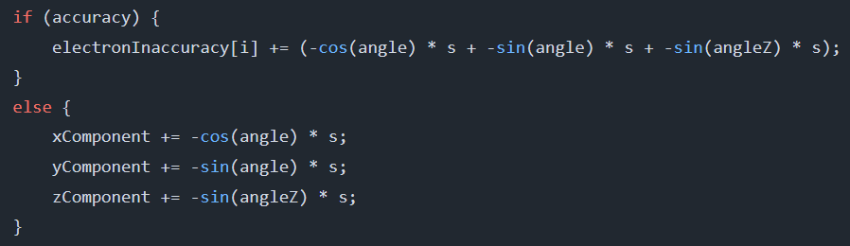
Benchmarking
To adequately test optimisation two benchmarks were developed:
Timing
The main benchmark was the time taken to calculate the force for each electron.
This will be mainly used to illustrate the complexity of the simulation.
Accuracy
Accuracy will be used at times to determine whether the simulation accuracy is being undermined for performance.
Each test was run multiple times to ensure consistent results.
Figure 5: Timing Implementation
Figure 4: Accuracy Implementation

Slide 7
Let’s optimise!

Slide 8
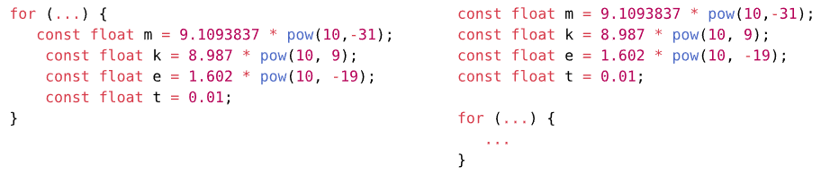
Remove loop invariant code
A simple optimisation technique is to remove invariant code!
Figure 6: What was removed from the loop invariant

Slide 9
Remove loop invariant code: performance
While removing loop invariant code is a simple technique, does make an impact!
Figure 7: Average Time Per Loop after Optimising
This was 8μs per loop or 0.008 in total, which isn’t much, but it’s something!

Slide 10
Let’s Continue optimising!

Slide 11
EXIT loops early if possible: Distance
Another simple optimisation technique is to exit loops if possible.
This was first considered by using arbitrary distance cutoffs.
Figure 8: Performance of the Average Loop with Distance Cutoffs

Slide 12
EXIT loops early if possible: Distance
Figure 8 Performance of the Average Loop with Distance Cutoffs
Figure 8 indicates that Distance cutoffs vastly improve performance
Compared to the baseline, performance was improved by at minimum 40% (Dist 7), with a 76% with the 3m cutoff.
However, the accuracy of the simulation should also be considered.

Slide 13
EXIT loops early if possible: Distance
To measure the accuracy of the simulation, whenever, it would have ignored a loop, it was added to a sum for each electron which was then averaged.
Figure 9: Inaccuracy averaged across all electrons over all loops

Slide 14
EXIT loops early if possible: Distance
Figure 9: Inaccuracy averaged across all electrons over all loops
To measure the accuracy of the simulation, whenever, it would have ignored a loop, it was added to a sum for each electron which was then averaged.
The accuracy at lowest decreases by 0.25cm per loop with the decrease for the 7m cutoff was only 0.05cm per loop.

Slide 15
Let’s Continue optimising!

Slide 16
EXIT loops early if possible: Force
Another variable to end the loop was force. Force cutoffs were implementing across a variety of ranges but was not used due to an evident issue.
Figure 10: Performance of the Average Loop with Distance Cutoffs

Slide 17
EXIT loops early if possible: Force
Figure 10: Performance of the Average Loop with Distance Cutoffs
Figure 10 raised a number of concerns.
It was expected that a high force cutoff would perform better, yet there was no difference, excluding F = 1.
All these runs were tested multiple times, and results were consistent.

Slide 18
EXIT loops early if possible: FOrce
Figure 11: Inaccuracy averaged across all electrons over all loops
Figure 11 continues to identify the peculiarities with the force cutoffs.
All force cutoffs produced an identical inaccuracy.
Force cutoff was not used forward on this project due to the inconsistency.

Slide 19
Let’s Continue optimising!

Slide 20
Spatial computing: chunking
Another technique to improve performance was to chunk the space.
This is to split the area into specific chunks and consider these individually.
Rather than considering all electrons in all grids, when applying the force, the aggregated force from each grid was considered and its position.
Figure 12: Performance of the 5 by 5 by 5 and 10 by 10 by 10 Chunked

Slide 21
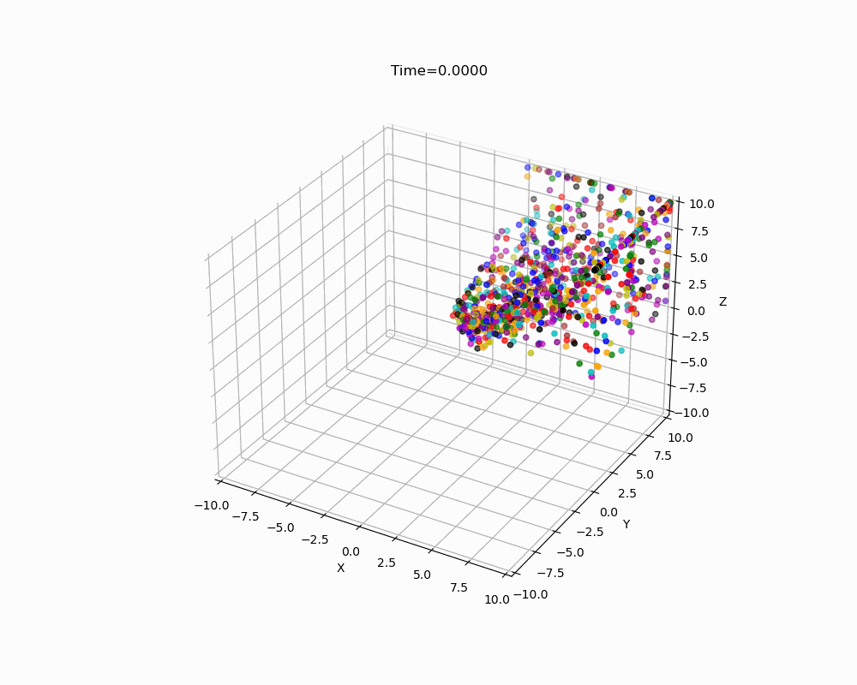
Spatial computing: chunking
Whilst the performance of both grids certainly improved performance, there were odd behaviours caused by this implementation.
This was believed to be caused by the averaging of the location of the charge.
Figure 13: Odd Behaviour Exhibited of the Chunking Implementation

Slide 22
Final optimisation

Slide 23
Spatial computing: octree
Another technique to improve performance was to implement an octree.
This is a recursive structure which splits the space into partitions of eight octants.
Figure 14: Performance all Spatial Computing Techniques Compared to Baseline

Slide 24
Spatial computing: octree
Figure 14: Performance all Spatial Computing Techniques Compared to Baseline
The Octree implementation resembled the original implemented the closest.
It performed in between the 5 by 5 by 5 grid and 10 by 10 by 10, whilst matching the 10 by 10 by 10 in terms of accuracy, excluding the 3m.

Slide 25
Conclusion
Throughout this project, a serial implementation of an electron interaction simulation has been implemented.
Multiple optimisations were implemented;
Remove loop invariant code
Exit loops early if possible
Exiting by Distance
Exiting by Force (did not behave as expected)
Spatial Computing: Chunking
Accuracy of the simulation was compromised
Spatial Computing: Octree
The most effective in terms of performance
Figure 1: Final Implementation of Project

Slide 26
Conclusion: Reflection
Overall, this project I learnt a significant amount
About cpp, which I was unfamiliar with before starting this, and
Spatial computing which I was similarly unfamiliar with.
Both techniques that encountered issues were likely resulting from implementation details.
They could have been fixed or resolved, but rather I chose to move to focus on larger improvements
Milestone 2 will consist of extending this implementation to consider how to parallelise the octree implementation
This is often used in graphics or raytracing, so it will likely be using CUDA
Figure 14: Performance all Spatial Computing Techniques Compared to Baseline

